Slide 1
Mongodb-Project
Big data analytics track Project – Submitted by Shalini gupta

Slide 2
Profile Details
Name: Shalini Gupta
Email ID: shalini2501@gmail.com
Course Enrolled: Big Data Analytics
Project Name: MongoDB

Slide 3
Project Details
Domain: Queries on business data
Topic: MongoDB Queries
Technology used: NoSQL

Slide 4
Project Introduction
MongoDB is a NoSQL database Management system.
The project is on running queries on JSON data using Mongo.
Dataset: business.json

Slide 5
Dataset Description
Meta Data:
business_id
full_address
hours
Object type: days name
Close and open time
open
categories
Array type
city
review_count
name
neighborhoods
longitude
state
stars
latitude
attributes
Object type: various attributes listed respect to categories
type

Slide 6
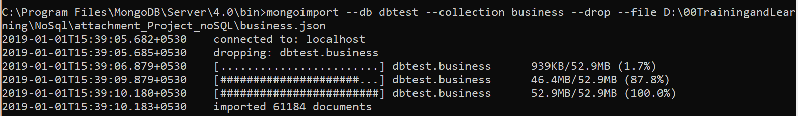
Question 1: Load the data into MongoDB client and make a collection named as Business.
To load the data in MongoDBClient, used the following command at command prompt:
Mongoimport --db MyDb --collection business --drop --file <json file path>

Slide 7
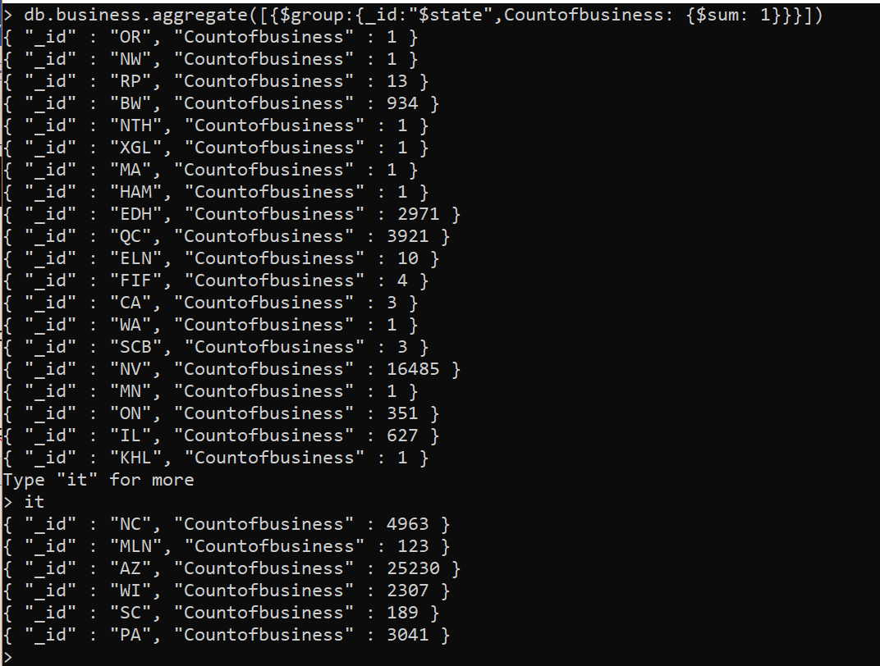
Question 2: Display state and count the number of businesses corresponding to the state.
db.business.aggregate([{$group:{_id:”$state”,Countofbusiness: {$sum: 1}}}])

Slide 8
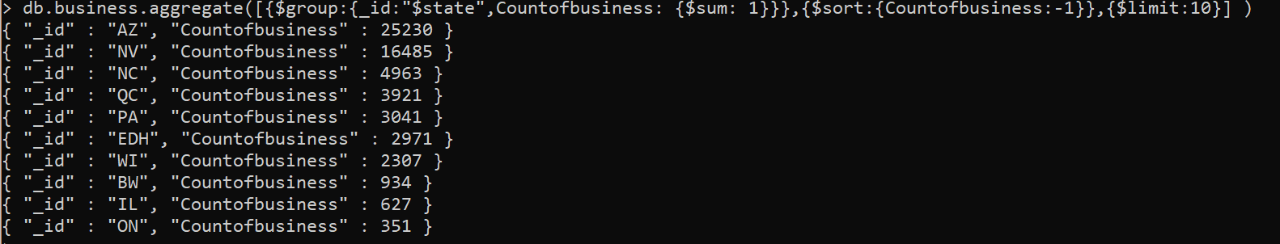
Question 3: Display state and count the number of businesses in descending order. And display top 10 records.
db.business.aggregate([{$group:{_id:"$state",Countofbusiness: {$sum: 1}}},{$sort:{Countofbusiness:-1}},{$limit:10}])

Slide 9
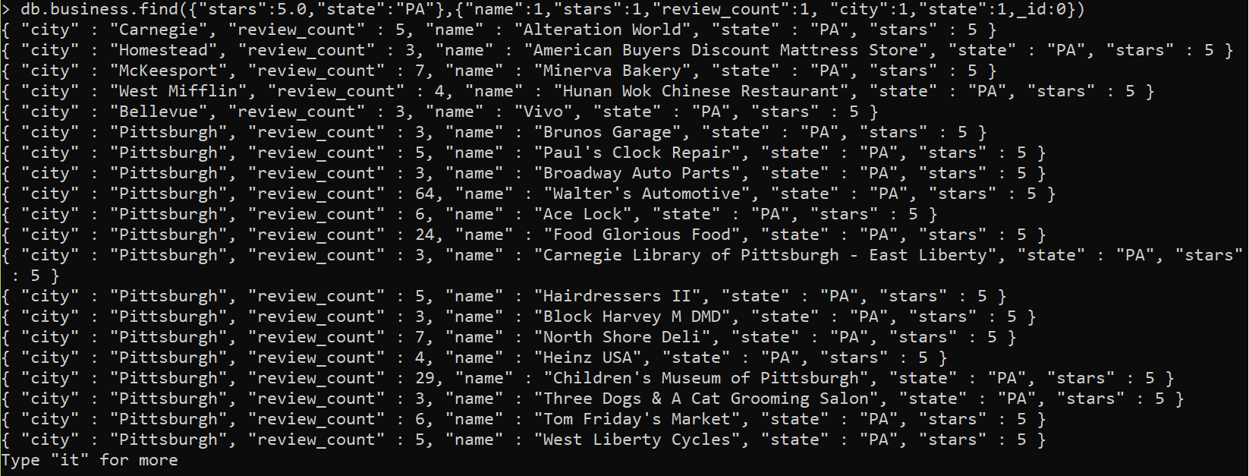
Question 4: Display name,stars, review_count,city and state whose star rating is 5.0 and state is PA.
db.business.find({"stars":5.0,"state":"PA"},{"name":1,"stars":1,"review_count":1, "city":1,"state":1,_id:0})

Slide 10
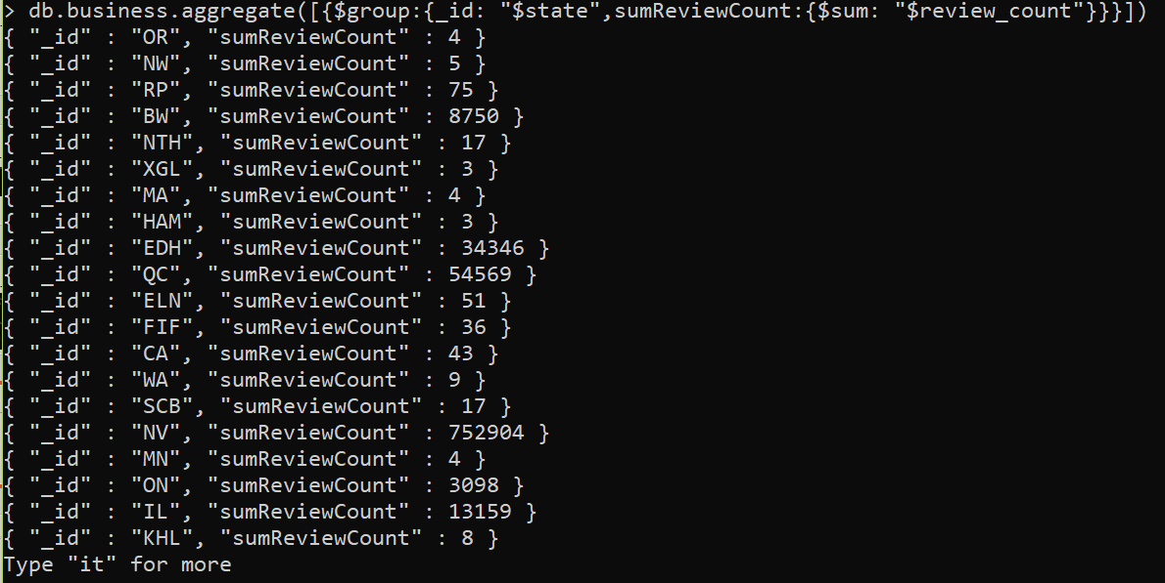
Question 5: Display state and sum of review_count on the basis of state.
db.business.aggregate([{$group:{_id: "$state",sumReviewCount:{$sum: "$review_count"}}}])

Slide 11
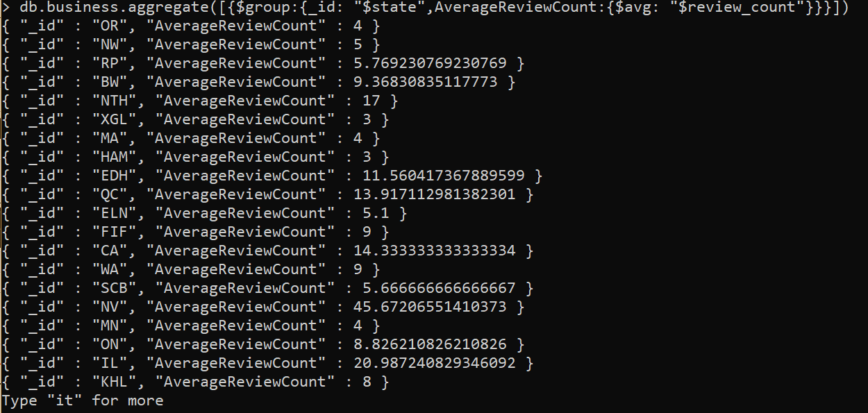
Question 6: Display state and average of review_count on the basis of state.
db.business.aggregate([{$group:{_id: "$state",AverageReviewCount:{$avg: "$review_count"}}}])

Slide 12
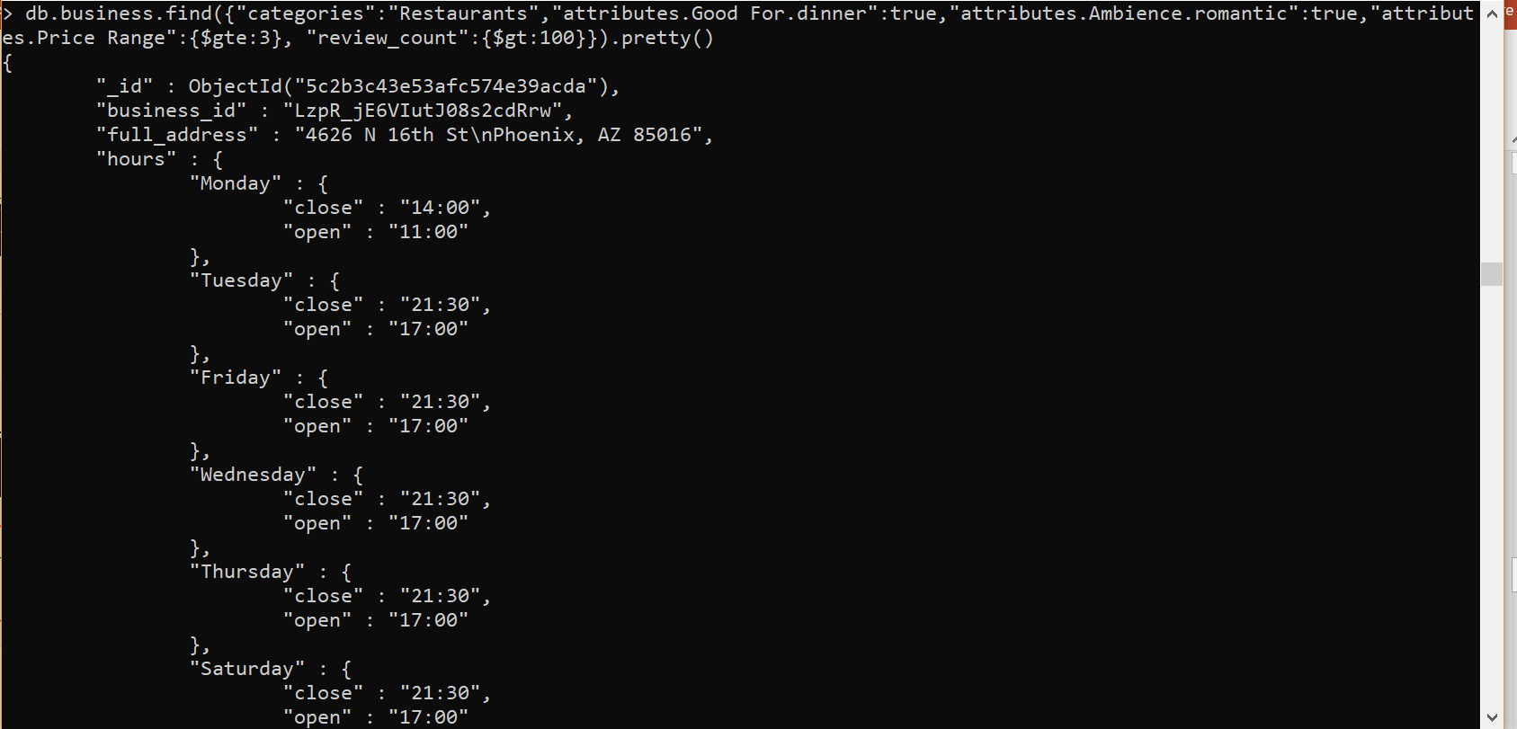
Question 7: Find all restaurants which is good for dinner , having a romantic ambiance with a price range greater than or equal to three and is having more than 100 reviews.
db.business.find({"categories":"Restaurants","attributes.Good For.dinner":true,"attributes.Ambience.romantic":true,"attributes.Price Range":{$gte:3}, "review_count":{$gt:100}}).pretty()

Slide 13
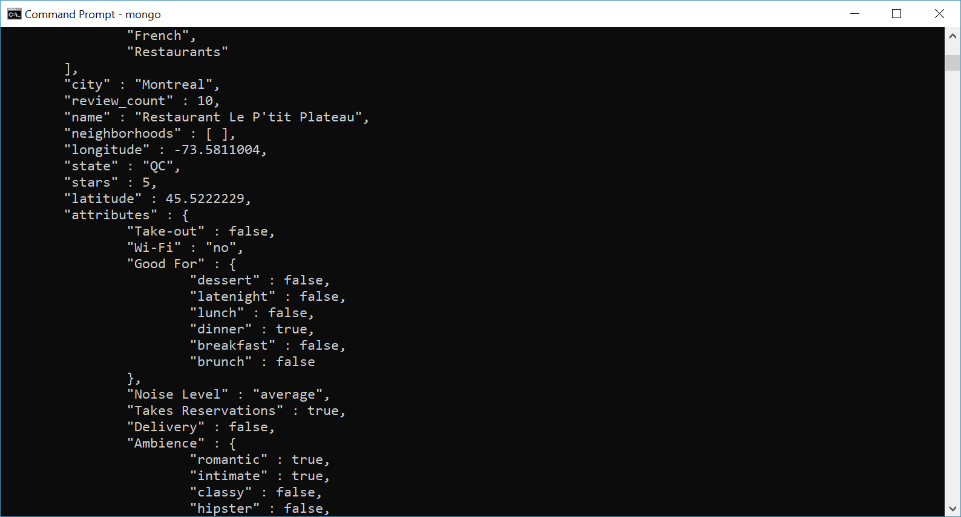
Question 8: Find the reviews of Romantic, good for dinner restaurants having a useful votes greater than or equal to 5.
db.business.find({"categories":"Restaurants","attributes.Good For.dinner":true,"attributes.Ambience.romantic":true,"stars":{$gte:5}}).pretty()

Slide 14
Question 9: For business id mVHrayjG3uZ_RLHkLj-AMg change the city to Pittsburgh.
Old record:
Update Command:
db.business.updateOne({"business_id": "mVHrayjG3uZ_RLHkLj-AMg"}, {$set:{"city": "Pittsburgh"}})
Update record:

Slide 15
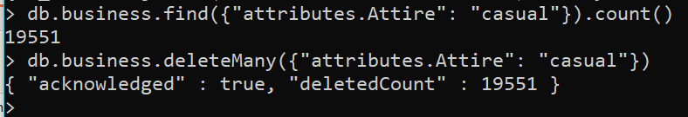
Question 10: Remove all the documents which is having Attire has 'casual'
db.business.deleteMany({"attributes.Attire": "casual"})

Slide 16
Thank you!!

